Slide 1
6 – Clean Code – TDD part 1
Based on the CleanCoders videos by Uncle Bob Martin
Rupert Waldron

Slide 2
Introduction
We saw in the original presentation how code rots, becomes fragile and rigid. Changes take for ever and often require changes to many modules and break unexpected parts of the cause, or cause unexpected behaviors.
Solution… clean the code
We don’t clean it because we are afraid we would break it… and if you break it, it will become yours!!
We need to eliminate the FEAR

Slide 3
Eliminating the fear
With a fantastic test suite… created using Test Driven Development

Slide 4
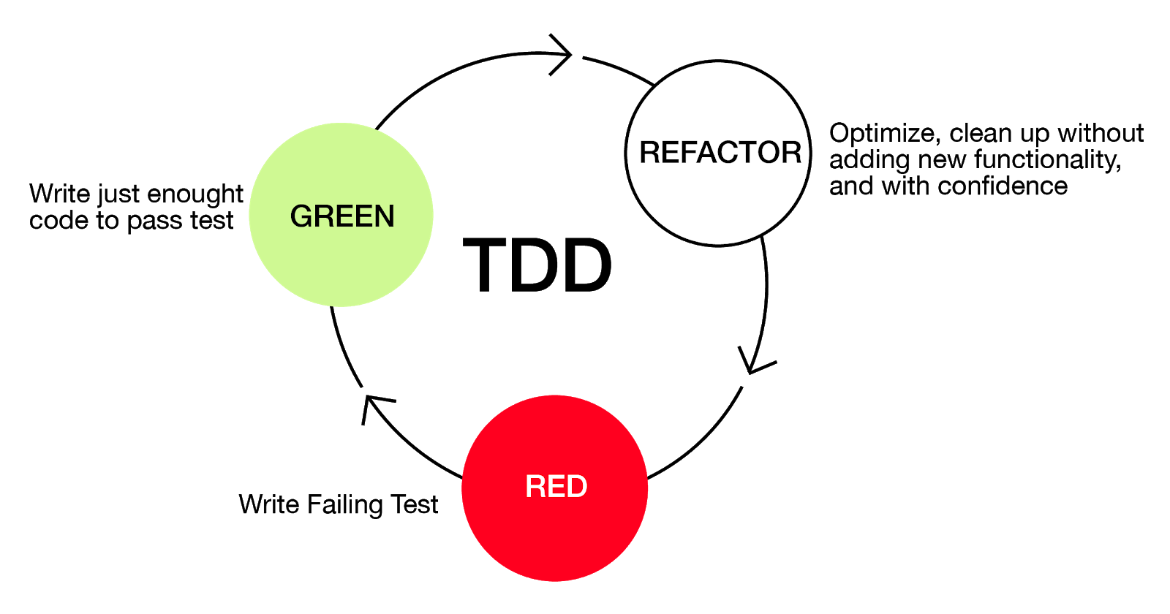

The Three Laws of TDD
Not compiling is also failing
Start here

Slide 5
Some of the benefits
Writing tests firsts makes production code testable – this means to code will naturally be de-coupled
You are only a few minutes away from fully working code as each cycle should only take a few minutes
You have ready to go documentation because all the use of the code is demonstrated by the test suite.
Think of testing as double entry book-keeping – accounting is subject to single digit errors – just like software.

Slide 6



















What would happen if you had a suite of tests that gave you a very high degree of confidence that the tests were working?

Slide 7
Objections to TDD
Tests are more code – it must slow you down.
You actually go faster because you will spend much less time debugging.
You are constantly working in a clean code base - you can refactor without fear.
Mangers raise objections because they think it will take longer.
Just don’t tell them, you don’t tell them about other ways you code.
Refactoring is rework, it would be better to write the code right the first time.
All creative work is done iteratively: art, literature etc.
Who tests the tests?
The production code tests the tests.
A small change to code breaks lots of tests.
If tests are testing implementation and / or are poorly designed they will break frequently (too coupled to the production code). Aim to test the public api – e.g. Petstore

Slide 8
Objections to TDD cont…
Tests can’t prove the code correct
The purpose of tests is to create a parachute – eliminate the fear of making change.
You can write your tests after the code.
Things that come at the end are less important - tests can be missed out.
The tests are more important than the code – they stop the code from rotting, they are also the requirements.
Testing GUIs.
Avoid testing GUIs. Test the code one layer back from that – separate the GUI into the presenter and the view. Then test the presenter.

Slide 9
Code Coverage
The goal should be 100%
This is almost never achievable, but it should still be the goal

Slide 10
Over to the petstore api… tdd style

